Slide 1

Chapter 6
Integrating Agent-Based Modelling and GIS
Notes:
Building on previous chapters outlining the fundamentals of GIS and agent-based modelling, what are the benefits to linking these approaches? How is this undertaken? This chapter will explain loose and tight coupling critiquing the relative advantages and disadvantages of both. We present an overview of open source toolkits that can be used for the creation of geographically explicit agent-based models before providing a critical look at where and how GIS and ABM should be combined offering practical advice on best practice.

Slide 2
Learning Objectives

Slide 3
Introduction

Slide 4
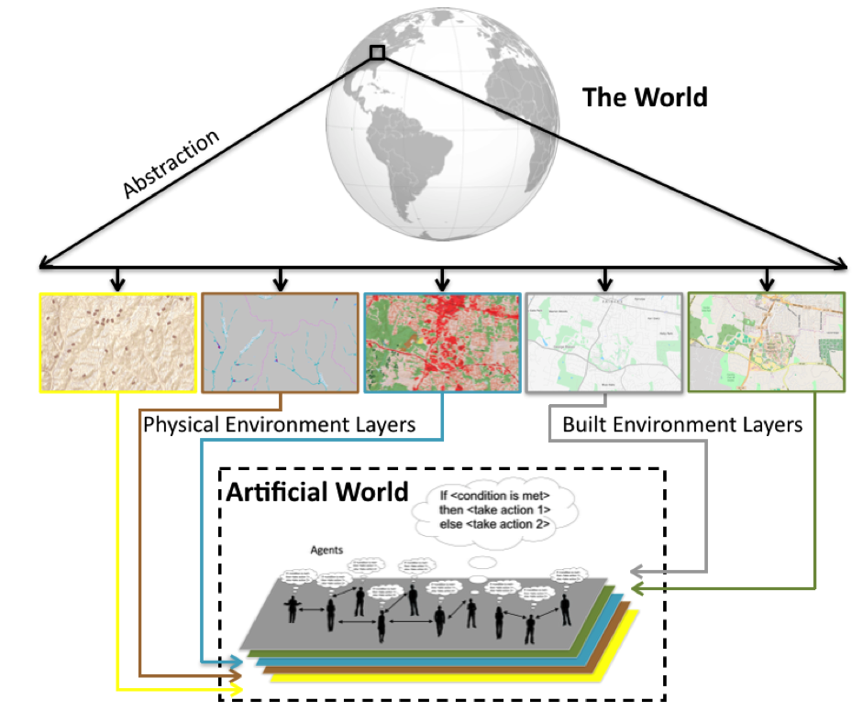
Creating an ‘Artificial World’ from GIS Data
Figure 6.1: Abstracting from the “real” world into a series of layers to be used in the artificial world for which to base the agent-based model upon.

Slide 5
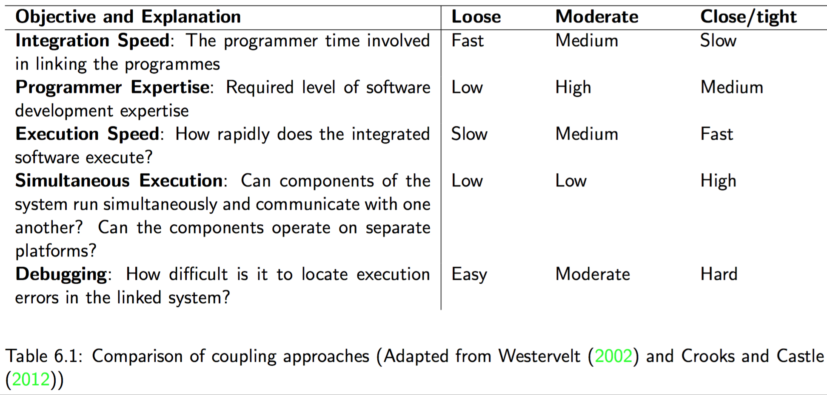
Coupling and Embedding GIS and Agent-based Models

Slide 6
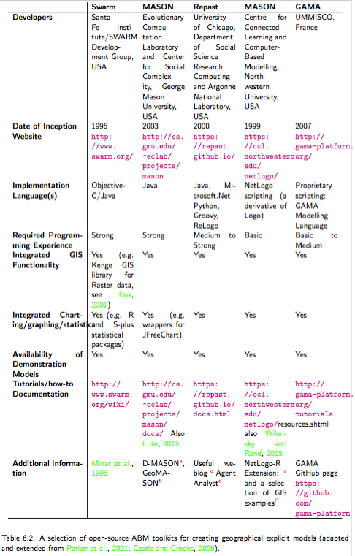
Tools for Constructing and Developing Agent-based Models

Slide 7
Swarm

Slide 8
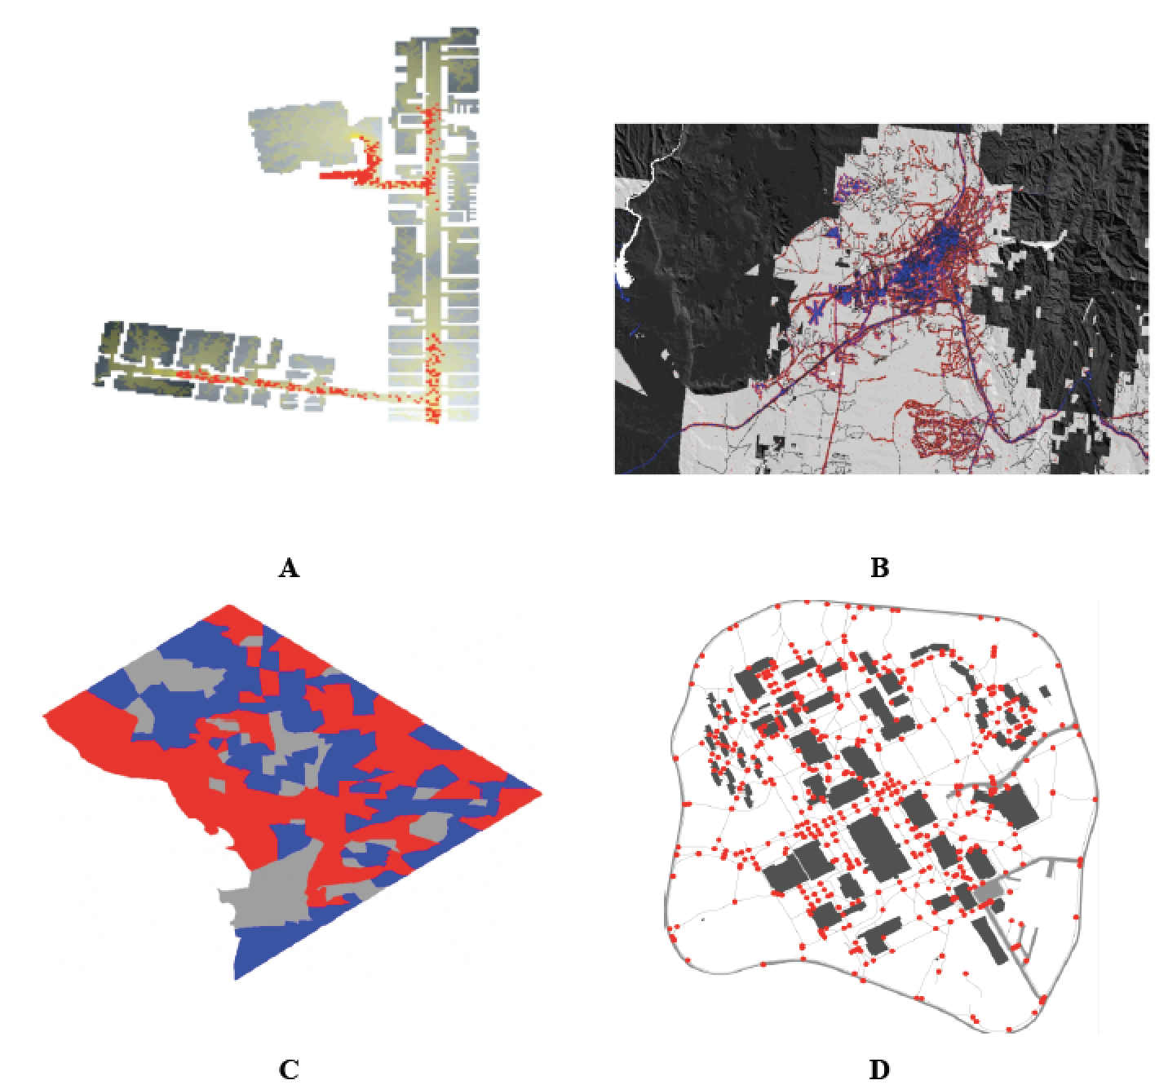
MASON
Figure 6.2: A selection of MASON spatial models (A): Agents (red) exiting a building based on raster data and the resulting trails (yellow). (B) An urban growth model where red areas represent new developments. (C) A Schelling type of model using census areas in Washington DC as its spatial environment. (D) Agents (red circles) moving along on sidewalks (grey lines).

Slide 9
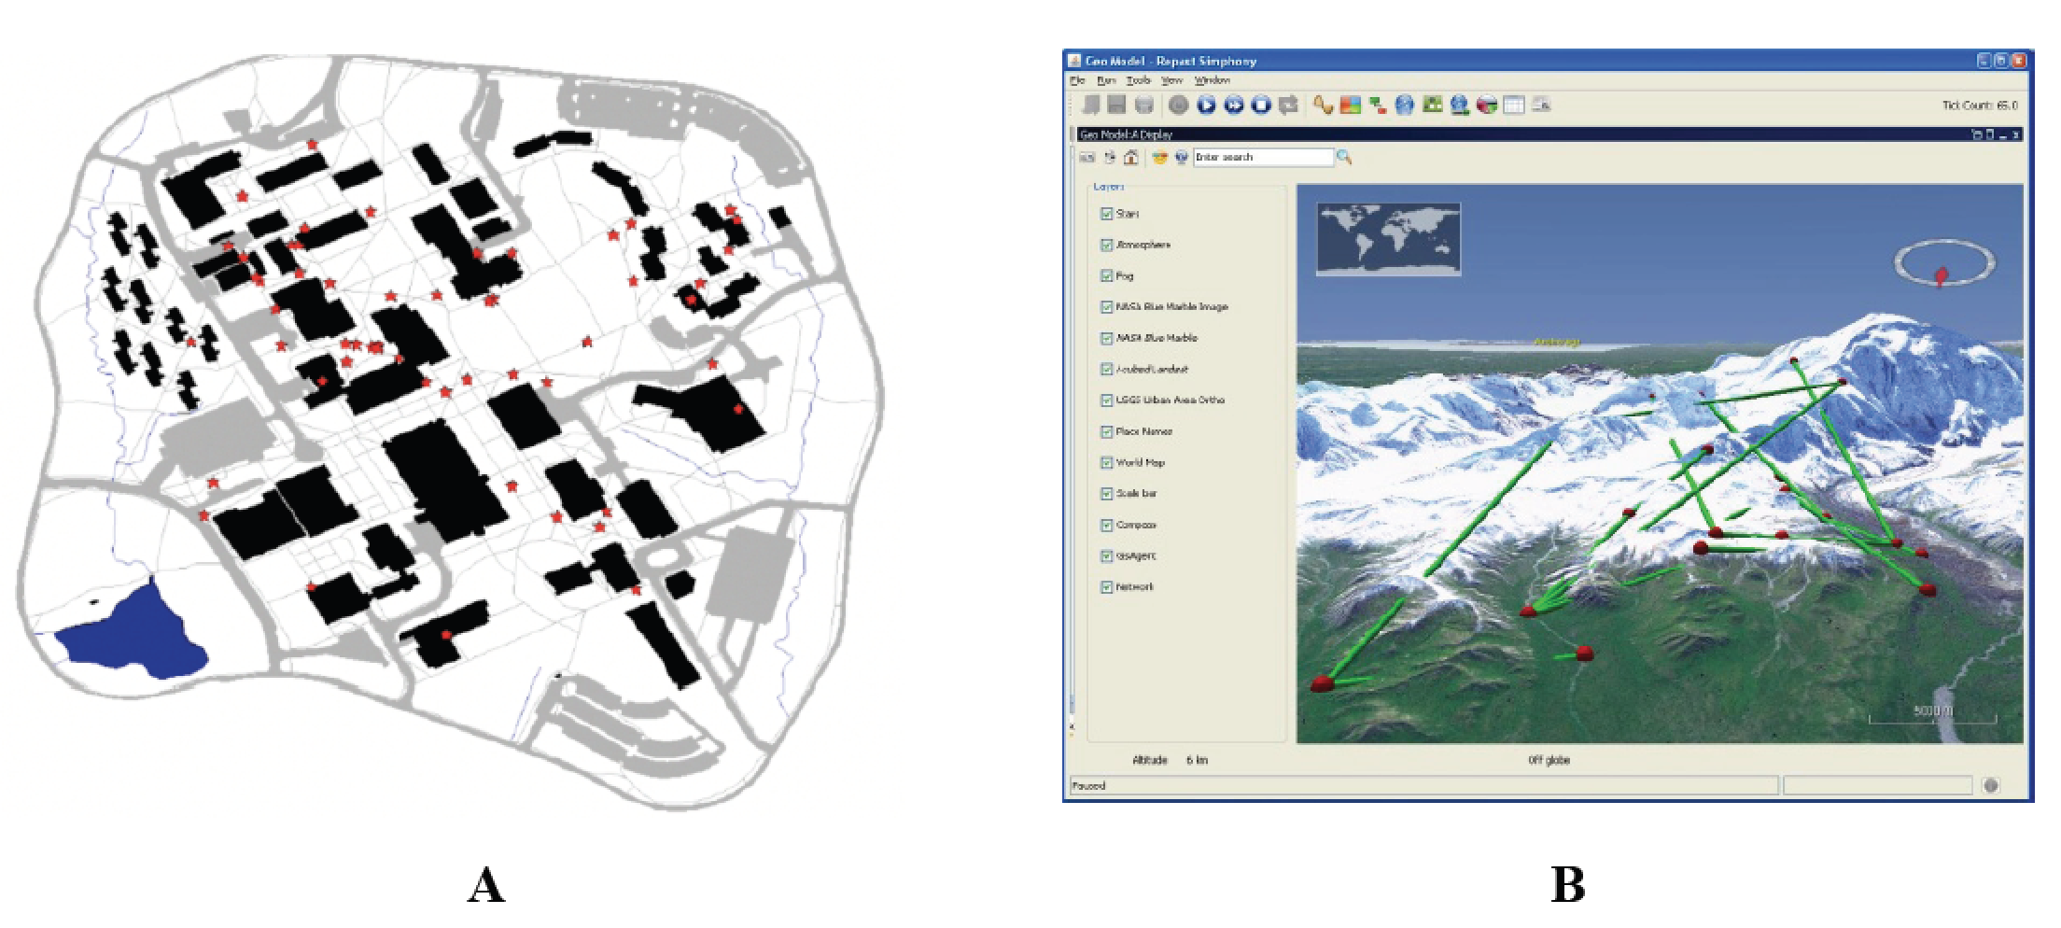
Repast
Figure 6.3: Examples of vector agent-based models in Simphony. (A) Agents (red stars) moving along on sidewalks (grey Lines). (B) An agent-based model overlaid on NASA world wind (Source: Repast, 2016)

Slide 10
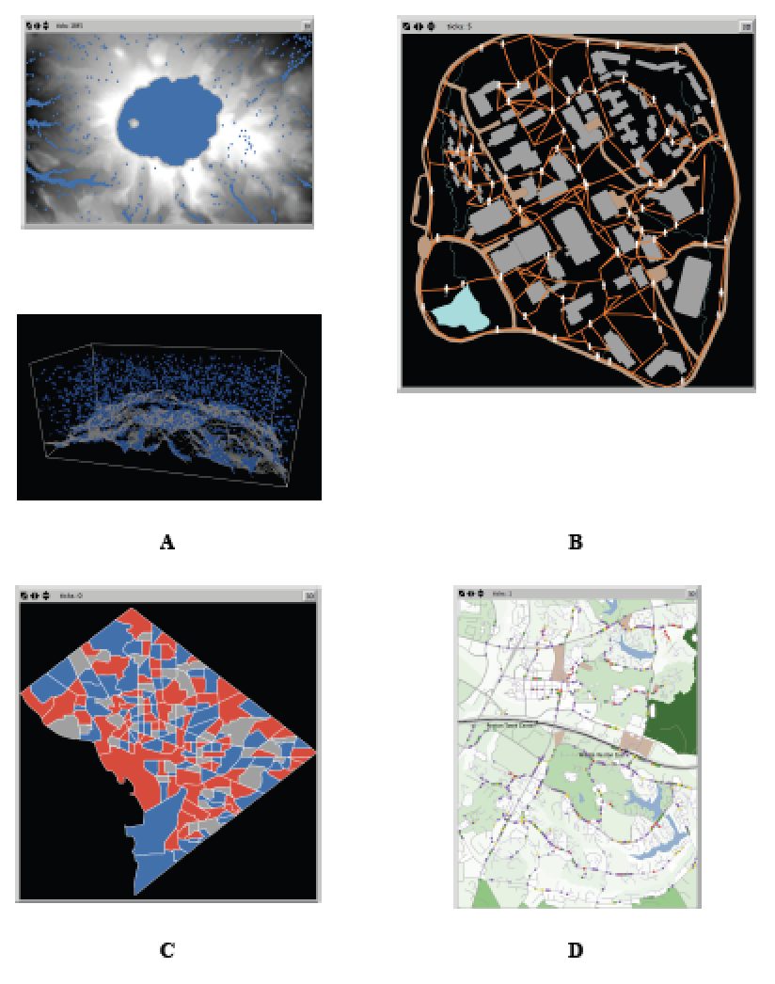
NetLogo
Figure 6.4: A selection of geographically explicit agent-based models utilising NetLogo. (A) Rainfall where rain (blue) falls and flows to a lower elevation based on a digital elevation model captured in 2 and 3D. (B) Agents (white) moving along on sidewalks (orange). (C) Schelling type model using census areas in Washington DC as their spatial environment. (D) Commuting along a road network.

Slide 11
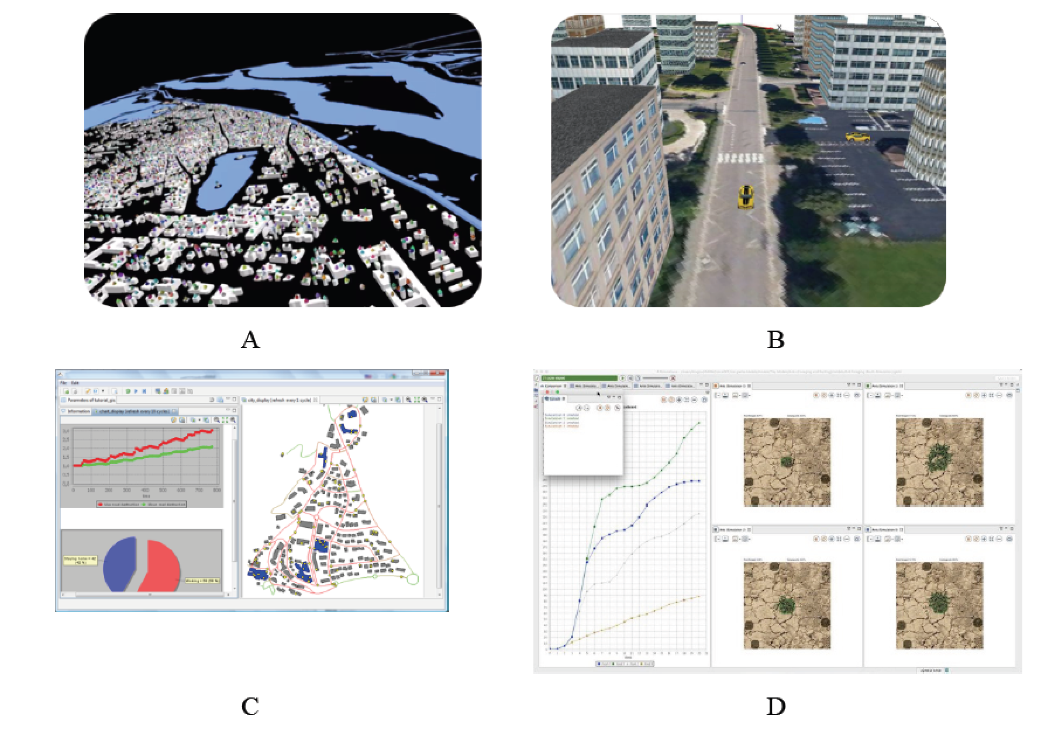
GAMA
Figure 6.5: GAMA platform: Advanced visualisation of simulations (A and B). (C) Built in charting and functions. (D) User interface (Source: GAMA, 2016).

Slide 12
Using Raster Data in NetLogo

Slide 13
Raster Model Examples: Urban Growth and Pedestrian Modelling

Slide 14
Urban Growth

Slide 15
Pedestrian Modelling

Slide 16
Discussion
Since their first appearance in the late 1960s, GIS has become a standard tool for researchers interested in manipulating and visualizing spatial data.
Increases in the availability of different forms of open source data, is beginning to transform the GIS industry.
While GIS can easily enable the manipulation, analysis and visualization of spatial data, they are limited by their inability to handle dynamic processes.
How and why we bring agent-based modelling and GIS together is the subject of the following chapter.
Notes:
Geographical Information Systems (GIS) are the mainstay of many researchers tool box. The ability to easily manipulate, analyse and visualise data makes it a powerful tool. However, researchers need to be aware of the underlying principles behind GIS, such as the data structures that are used and the limitations of GIS, in particular, its limited ability to handle and simulate dynamic processes. This Chapter has laid out the fundamental concepts that researchers need to be aware of, and presented an overview of the most common proprietary packages. A simple tutorial demonstrated how to bring data into a GIS and perform a simple spatial query. The next chapter will build upon this foundation and introduce the concept of coupling GIS with ABM.

Slide 17
Summary
Geographical information systems are the mainstay of many researchers’ toolbox. The ability to easily manipulate, analyze and visualize data makes them a powerful tool.
This chapter has laid out the fundamental concepts that researchers need to be aware of and presented an overview of the most common proprietary packages.

Slide 18
Further Reading
More information about GIS functionality in NetLogo readers are referred to: https://ccl.northwestern.edu/netlogo/docs/gis.html along with the NetLogo GitHub page: https://github.com/NetLogo/GIS-Extension
While the website Simulating Complexity https://simulatingcomplexity.wordpress.com/2014/08/20/turtles-in-space-integrating-gis-and-netlogo provides a good tutorial on integrating GIS into NetLogo.
Key texts about the integration of GIS and agent-based modelling, readers are referred to:
Crooks, A.T. and Castle, C. (2012), 'The Integration of Agent-Based Modelling and Geographical Information for Geospatial Simulation', in Heppenstall, A., Crooks, A.T., See, L.M. and Batty, M. (eds.), Agent-based Models of Geographical Systems, Springer, New York, NY, pp. 219-252.
Maguire, D.J., Batty, M. and Goodchild M, F. (eds.) (2005), GIS, Spatial Analysis and Modelling, ESRI Press, Redlands, CA.
Westervelt, J.D. (2002), 'Geographic Information Systems and Agent-Based Modelling', in Gimblett, H.R. (ed.) Integrating Geographic Information Systems and Agent-Based Modelling Techniques for

Slide 19
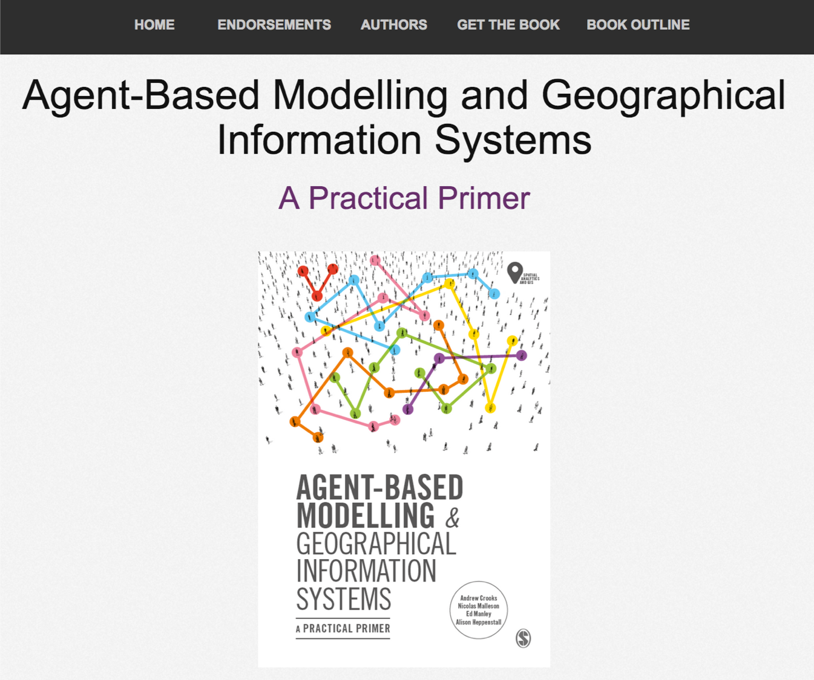
Online Resources
Visit: https://github.com/abmgis/abmgis/tree/master/Chapter06-IntegratingABMandGIS for a selection of models to highlight core concepts introduced in this chapter along with a tutorial.

